Slide 1
Design and FPGA Implementation of a
73-Tap Symmetric FIR Filter
Time-Multiplexed MAC Architecture on Xilinx Artix-7
Abdul Samad | Abdur Rehman
Chip Design & Verification · Ghulam Ishaq Khan Institute
Group 3 · September 2026
Notes:
73-tap linear-phase low-pass FIR on Artix-7. Two ideas: coefficient symmetry halves the multiplies (73 to 37), and time-multiplexing reuses one MAC 37 times so the whole filter fits in a single DSP slice.

Slide 2
Outline
1
Objective
8
RTL Modules & Control FSM
2
Project Schedule
9
SystemVerilog Code
3
Top-Level Block Diagram
10
Verification & Simulation
4
Specifications
11
Resource Utilisation
5
Fixed-Point Format
12
Timing & Critical Path
6
Coefficient Symmetry
13
Difficulties & Solutions
7
Time-Multiplexed MAC
14
Future Work & Conclusion

Slide 3
1
Objective
Implement a 73-tap low-pass FIR filter in SystemVerilog
Target: Xilinx Artix-7 FPGA
Match a bit-exact golden C model — zero tolerance
Minimise hardware: 1 multiplier, 1 adder, 1 accumulator
Demonstrate on real hardware via switches and LEDs
The Design Constraint
73 parallel multipliers will not fit on the device.
Trade area for latency — reuse one MAC unit over many clock cycles.
73
37
1
41 µs
filter taps
multiplications
DSP slice
for 100 samples
Notes:
A direct-form implementation needs one multiplier per tap. Folding plus time-multiplexing brings that to a single DSP48E1.

Slide 4
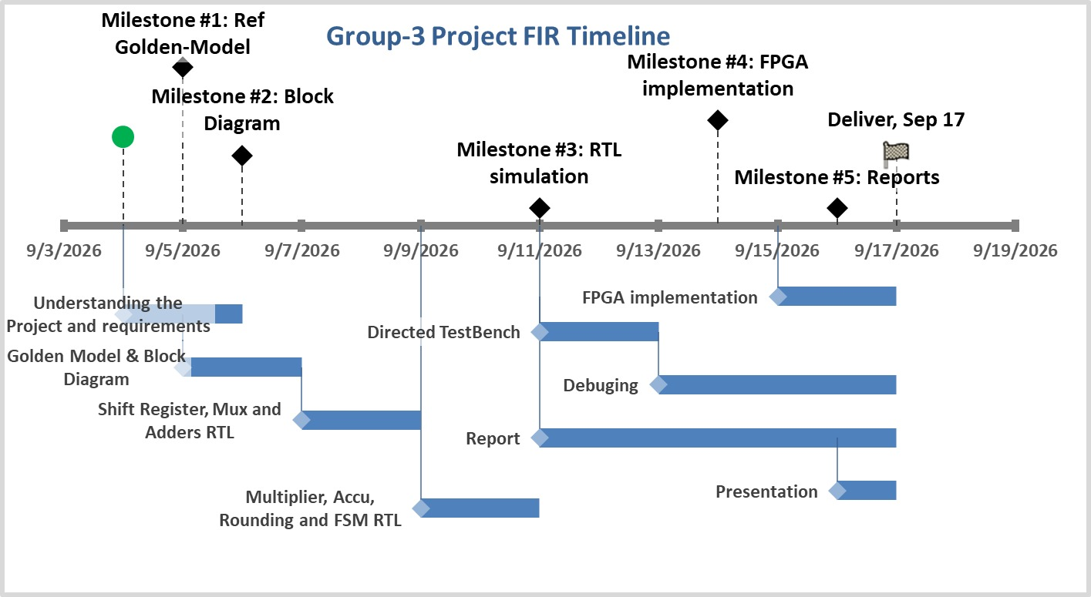
2
Project Schedule
Golden model → block diagram → RTL & simulation → FPGA implementation → reports
Notes:
Five milestones. The golden C model came first deliberately: it is the specification the RTL is measured against.

Slide 5
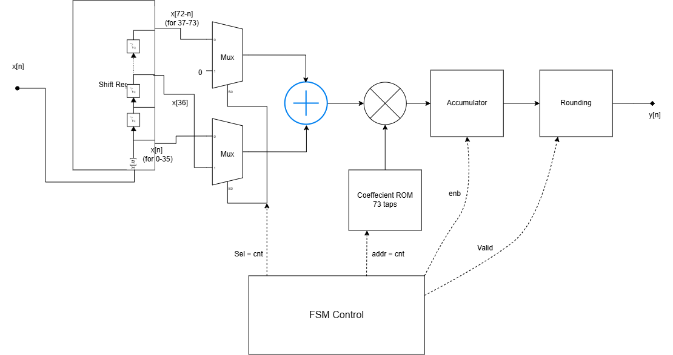
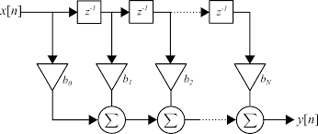
3
Top-Level Block Diagram
Shift register → tap-pair mux → adder → multiplier → accumulator → rounding → y[n]
Notes:
One counter, cycle_cnt, drives both the tap mux and the coefficient ROM address. That shared counter is the essence of time-multiplexing.

Slide 6
4
Filter Specifications
Parameter | Value
Filter type | FIR, low-pass, linear phase
Number of taps N | 73
Symmetry | h[k] = h[72 − k]
Input word | 16-bit signed
Coefficient word | 16-bit signed
Output word | 16-bit signed
Multipliers used | 1 (DSP48E1)
Clock frequency | 100 MHz
Test vector length | 100 samples
Difference equation
y[n] = Σ h[k] · x[n − k]
k = 0 … 72
Why 73 taps?
More taps give a sharper transition band. We absorbed the cost with folding rather than reducing the tap count.

Slide 7
5
Fixed-Point Format
Signal | Width | Format | Frac. bits | Range
Input x[n] | 16 | Q(3,10) | 10 | ± 4
Coefficient h[k] | 16 | Q(2,14) | 14 | ± 2
Tap sum | 16 | Q(4,10) | 10 | +1 extra bit
Product | 32 | Q(6,24) | 24 | —
Accumulator | 38 | Q(12,24) | 24 | +6 guard bits
Output y[n] | 16 | Q(3,13) | 13 | ± 4
Guard bits
⌈ log₂ 37 ⌉ = 6
32 + 6 = 38 bits
The accumulator provably cannot overflow.
Output stage
round (+ 2¹⁰)
shift (>>> 11)
saturate to ± 32767
24 fractional bits in the product, 13 wanted at the output → discard 24 − 13 = 11 bits.
Notes:
Coefficients get the most fractional bits because they peak at exactly 1.0 — 14 bits is the most precision that still represents 1.0 in 16 bits.

Slide 8
6
Coefficient — Folding
Linear-phase FIR ⇒ h[k] = h[N − 1 − k]
Cycle | Tap pair | Coeff
0 | x[0] , x[72] | h[0]
1 | x[1] , x[71] | h[1]
⋮ | ⋮ | ⋮
35 | x[35] , x[37] | h[35]
36 | x[36] , 0 | h[36]
y[n] = Σ h[k] ( x[n−k] + x[n−72+k] ) + h[36] · x[n−36]
k = 0 … 35 centre tap
73 multiplies → 37 multiplies
Coefficient ROM: 73 → 37 words
49 % arithmetic saving, zero accuracy loss
It is an algebraic identity, not an approximation
The centre tap is unpaired — the second mux outputs zero so h[36] is counted exactly once.

Slide 9
7
Time-Multiplexed MAC
MAC = Multiply–Accumulate one unit that computes acc ← acc + a × b every clock cycle
Only one multiplier and one accumulator exist in hardware
They are reused 37 times per output sample
A single counter drives the tap mux and the ROM address
The accumulator is cleared at the start of every new sample
 | Fully parallel | Time-multiplexed
Multipliers | 73 | 1
Cycles per sample | 1 | 41
DSP slices | > 73 | 1
Fits on Artix-7 | No | Yes
Area is traded for latency — and at 2.4 MSa/s the latency costs nothing.

Slide 10
8
RTL Module Hierarchy
Module | Function | Type
top | Integration, debouncer, output RAM, LEDs | —
input_rom | 100 × 16 test vectors | ROM
shift_reg | 73 × 16 delay line | Sequential
tap_pair | Selects x[k] and x[72−k] | Comb. mux
tap_adder | x[k] + x[72−k] | Combinational
coeff_rom | 37 × 16 coefficients | ROM
multiplier | sum × coeff (32-bit) | DSP48E1
accumulator | 38-bit running sum | Sequential
rounding | Round / shift / saturate | Comb. + reg
control_fsm | 5-state Moore controller | Sequential
Notes:
Ten modules. shift_reg alone accounts for 1168 of the 1220 flip-flops.

Slide 11
9
Control FSM
IDLE
State | Active signal | Cycles
IDLE | — | 1
LOAD | shift_en, clear | 1
COMPUTE | acc_enb | 37
ROUNDING | — | 1
OUTPUT_READY | out_enb | 1
Total per sample |  | 41
LOAD
COMPUTE × 37
ROUNDING
OUTPUT_READY
Moore machine
Outputs depend on the state alone, so every control signal is stable for the whole cycle — glitch-free and safe to drive enables.
loops back to IDLE
Notes:
COMPUTE is 37 cycles because cycle_cnt runs 0 to 36 inclusive. 100 samples x 41 = 4100 cycles = 41 microseconds at 100 MHz.

Slide 12
10
Code — Control FSM
case (state)
IDLE: if (sample_valid) next_state = LOAD;
LOAD: begin
shift_en = 1'b1; // push the new sample in
clear = 1'b1; // zero the accumulator
next_state = COMPUTE;
end
COMPUTE: begin
acc_enb = 1'b1; // 37 MAC cycles
if (cycle_cnt == 6'd36) next_state = ROUNDING;
end
ROUNDING: next_state = OUTPUT_READY;
OUTPUT_READY: begin out_enb = 1'b1; next_state = IDLE; end
endcase
Why defaults matter
All four control signals are assigned 0 before the case runs. Every output therefore has a value on every path — which is what prevents inferred latches.
Why a ROUNDING state?
Round–shift–saturate is a long combinational path off a 38-bit accumulator. This state gives it a full clock cycle to settle before OUTPUT_READY registers the result.

Slide 13
11
Code — Tap-Pair Mux
always @(*) begin
case (sel)
0: begin mux_low = tap[0]; mux_high = tap[72]; end
1: begin mux_low = tap[1]; mux_high = tap[71]; end
// ...
35: begin mux_low = tap[35]; mux_high = tap[37]; end
36: begin mux_low = tap[36]; mux_high = '0; end
default: begin mux_low = '0; mux_high = '0; end
endcase
end
Case 36 — the centre tap
x[n−36] has no partner. Forcing mux_high to zero makes the adder compute x[n−36] + 0, so h[36] multiplies it exactly once instead of twice.
Cost
Two 37-to-1 muxes ≈ 400 LUT6 + 129 MUXF7 — and they sit on the critical path.
The default branch is mandatory
sel is 6 bits, so values 37–63 are reachable. Without a default those leave the outputs unassigned and Vivado infers 32 latches — level-sensitive and untimeable.

Slide 14
12
Code — MAC Datapath
// adder : x[k] + x[72-k]
always @(*)
sum = tap1 + tap2;
// multiplier -> DSP48E1
always @(*)
product = sum * coeff;
// 38-bit accumulator
always @(posedge clk) begin
if (!rst || clear)
acc_out <= '0;
else if (acc_enb)
acc_out <= acc_out + product;
end
signed is the single most important keyword in the project. Without it the tools read 0xFF80 as +65408 instead of −128, and every negative sample gives a wrong product.
Vivado absorbs the multiplier and the accumulator into one DSP48E1
The 38-bit accumulator lives in the DSP's 48-bit P register — zero fabric flip-flops

Slide 15
13
Code — Rounding, Shift & Saturation
always @(*) begin
rounded = acc_in + (1 <<< (shift-1)); // + 2^10 round-half-up
shifted = rounded >>> shift; // >>> 11 ARITHMETIC
if (shifted > 38'sd32767) y_temp = 16'sd32767;
else if (shifted < -38'sd32768) y_temp = -16'sd32768;
else y_temp = shifted[15:0];
end
always_ff @(posedge clk) begin
if (!rst) begin y_out <= '0; valid <= 1'b0; end
else if (out_enb) begin y_out <= y_temp; valid <= 1'b1; end
else valid <= 1'b0;
end
Why >>> not >>
An arithmetic shift replicates the sign bit. With a logical shift every negative output would become a huge positive number.
Why add 2¹⁰ first?
A bare shift truncates, which biases every result toward −∞. Adding half of the last retained bit turns that into unbiased round-half-up.
Saturation, not wrap-around — a wrapped positive peak would become a large negative value. This matches the golden C model exactly.

Slide 16
14
Verification Methodology
1
Golden C model
Fixed-point reference — the specification
100 / 100
2
Generate vectors
input_samples.txt + coeffs_fixed.txt
samples match — bit-exact
0 mismatches
3
SystemVerilog testbench
Self-checking, reads the golden file
4
Compare sample by sample
Behavioural simulation: PASS
Counts pass / fail automatically
Post-synthesis: PASS
5
On-board check
Switches select address, LEDs show result
Hardware (Artix-7): PASS

Slide 17
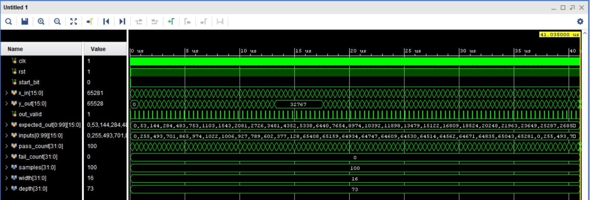
15
Simulation Waveform
Vivado behavioural simulation — self-checking testbench, pass_count = 100, fail_count = 0
Notes:
Point at pass_count and fail_count on the left, and the 41.035 microsecond marker top right.

Slide 18
16
Simulation Results
out_valid pulses exactly once per output sample
y_out tracks expected_out on every sample
pass_count reaches 100
fail_count stays at 0
The run completes at 41.035 µs
Signal | Final value
pass_count | 100
fail_count | 0
samples | 100
width | 16
depth | 73
Simulation end time | 41.035 µs
The measurement confirms the analysis
Predicted: 100 samples × 41 cycles × 10 ns = 41.00 µs Measured: 41.035 µs (the extra 35 ns is the 3-cycle reset)

Slide 19
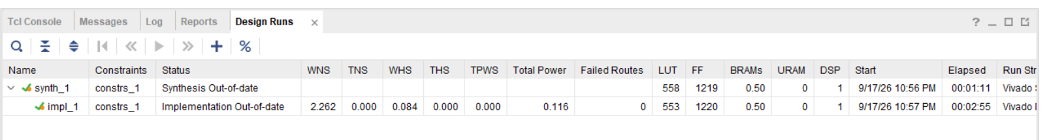
17
Resource Utilisation
Resource | Synthesis | Implementation
LUT | 558 | 553
FF | 1219 | 1220
BRAM | 0.50 | 0.50
DSP | 1 | 1
Total power | — | 0.116 W
1168 FF
73 taps × 16 bits — the shift register alone is 96 % of all flip-flops
1 DSP
carries the multiplier and the 38-bit accumulator together
0.5 BRAM
one RAMB18E1 half holding the 100-sample input ROM

Slide 20
18
Timing & Throughput
+2.262 ns
0
41 µs
129 MHz
worst negative slack
failed routes
for 100 samples
achievable clock
Metric | Value
Clock period (constraint) | 10.000 ns (100 MHz)
Worst Negative Slack (WNS) | +2.262 ns
Total Negative Slack (TNS) | 0.000 ns
Worst Hold Slack (WHS) | +0.084 ns
Total Hold Slack (THS) | 0.000 ns
Cycles per output sample | 41
Latency per sample | 410 ns
100 samples | 4100 cycles = 41.0 µs
22.6 % margin
All timing met — no setup and no hold violations anywhere in the design.
Maximum sample rate
100 MHz ÷ 41 = 2.44 MSa/s

Slide 21
19
Critical Path
The longest combinational path in the design — it sets the maximum clock frequency.
cycle_cnt
tap_pair
tap_adder
DSP48E1
register clk→Q
Two 37:1 mux
16-bit add
A / B setup
In parallel: cycle_cnt → coeff_rom (distributed ROM) → DSP48E1 B port
Timing budget | Value
Clock period (100 MHz constraint) | 10.000 ns
Data path + clock skew + setup | ≈ 7.738 ns
Worst Negative Slack (WNS) | + 2.262 ns
Why the mux dominates
Selecting 2 of 73 registers needs a deep LUT6 + MUXF7 tree. Removing it in the optimised build raised WNS from +2.262 to +3.257 ns.
Second-longest path: acc_out (38-bit) → round + arithmetic shift + saturation → y_out. The ROUNDING state gives it a cycle of its own.
Notes:
Path delay is derived from the constraint minus WNS: 10.000 - 2.262 = 7.738 ns. Run report_timing -max_paths 1 in Vivado to have it name the exact path.

Slide 22
20
Difficulties & Solutions (1 / 2)
Testbench output mismatched the golden model
1
Cause multiplier and accumulator ports were plain logic, so the arithmetic was unsigned — negative samples became huge positives.
Fix declare every arithmetic port logic signed.
No way to feed samples on hardware
2
Cause the testbench is not synthesisable, so the board has no source of stimulus.
Fix added an on-chip input_rom (100 × 16) with a read pointer advanced by out_valid.
$readmemh files not found during synthesis
3
Cause Vivado resolves data-file paths relative to the synthesis run directory, not the source directory.
Fix placed input_samples.txt and coeffs_fixed.txt in the synthesis run directory.

Slide 23
21
Difficulties & Solutions (2 / 2)
Results too fast to observe — 41 µs for 100 samples
4
Cause at 100 MHz the entire run finishes long before an LED can visibly change.
Fix results written into an on-chip output RAM; slide switches select the address and the LEDs display out_ram[sw].
Two LSBs of the LED output were wrong
5
Cause led[1] was mapped to an incorrect package pin in the XDC constraint file, giving a constant −2 offset on about half the samples.
Fix corrected the pin assignment — all 100 outputs then matched the golden model.
73 latches inferred in the tap multiplexer
6
Cause the case statement left the outputs unassigned for sel values 37–63.
Fix added a default branch so every output is assigned on every path.

Slide 24
22
Future Work — Further Resource Reduction
Key idea: don't move the data — move the addresses
The FIR maths never requires the 73 samples to physically shift. It only needs x[n−k] and x[n−72+k] each cycle.
Replace shift_reg + tap_pair with a circular buffer in distributed RAM
The samples stay still; two mod-73 pointers walk toward each other
The RAM address decoder replaces the 37:1 two muxes entirely
73 × 16 bits move from flip-flops into SLICEM LUTs
Before shift_reg + tap_pair
1168 FF + ~400 LUT6 + 129 MUXF7
After delay_line
~21 FF + ~90 LUT of distributed RAM
Supporting optimisations: bit-test saturation instead of two 38-bit comparators · power-of-two debounce counter instead of an 18-bit comparator

Slide 25
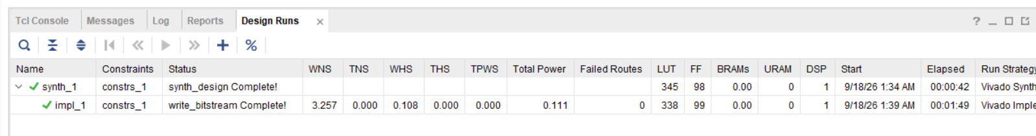
23
Future Work — Measured Result
Resource | Current | Optimised | Change
LUT | 553 | 338 | − 39 %
FF | 1220 | 99 | − 92 %
BRAM | 0.50 | 0 | − 100 %
DSP | 1 | 1 | —
WNS | 2.262 ns | 3.257 ns | + 0.995 ns
Power | 0.116 W | 0.111 W | − 4 %
Cycles / sample | 41 | 41 | unchanged
Timing improved too
The 73:1 mux was on the critical path — removing it buys area and speed at the same time.
1962 cells → 437 cells
Same throughput, bit-exact output, 0 failed routes.

Slide 26
24
Conclusion
A 73-tap linear-phase FIR filter was designed, verified and implemented on Artix-7
Coefficient symmetry halved the arithmetic: 73 → 37 multiplications
A time-multiplexed MAC fits the whole filter in a single DSP slice
Final resources: 553 LUT, 1220 FF, 1 DSP, 0.5 BRAM, 0.116 W
Timing closed with +2.262 ns slack; 100 samples in 41 µs
Hardware output is bit-exact with the golden C model
A circular buffer cuts the design to 338 LUT / 99 FF / 0 BRAM at the same throughput.

Slide 27
25
References
[1]
J. G. Proakis and D. G. Manolakis, Digital Signal Processing: Principles, Algorithms and Applications, 4th ed., Pearson, 2007.
[2]
Xilinx Inc., 7 Series DSP48E1 Slice User Guide (UG479), 2018.
[3]
Xilinx Inc., Vivado Design Suite User Guide: Synthesis (UG901), 2022.
[4]
Xilinx Inc., 7 Series FPGAs Memory Resources User Guide (UG473), 2019.
[5]
IEEE Std 1800-2017, IEEE Standard for SystemVerilog, IEEE, 2018.
[6]
VHDLwhiz, "FIR filter design — Part 2," online tutorial.
[7]
rombarak, "FIR-Filter," GitHub repository.
[8]
Anthropic, "Claude AI," used for design review and documentation assistance.

Slide 28
Thank You
Questions?
Abdul Samad | Abdur Rehman
Chip Design & Verification · Group 3

